Slide 1
PATIENTS SUMMARY DASHBOARD IN POWER BI
PRESENTED BY - KAVYA

Slide 2
INTRODUCTION
In today's data-driven business environment, organizations are increasingly relying on analytics to gain insights into customer behavior and performance. A Patients Summary Dashboard created using Power BI is a powerful tool that enables businesses to visualize, analyze, and interpret customer-related data in real time. This dashboard helps in making informed decisions, optimizing customer engagement strategies, and enhancing overall business performance.
A Patient Summary Dashboard in Power BI is a powerful tool designed to provide healthcare professionals with an intuitive and comprehensive overview of patient data. This dashboard leverages the capabilities of Power BI to integrate, analyze, and visualize various patient-related metrics, facilitating better decision-making and enhancing patient care.
02

Slide 3
PROBLEM STATEMENT
Enhancing Patients Insights with a Performance Dashboard in Power BI
Involves integrating comprehensive data sources, utilizing advanced analytics, and implementing interactive visualizations to provide a holistic view of patient care. By leveraging predictive analytics, real-time monitoring, and risk stratification, healthcare providers can proactively manage patient health, identify high-risk individuals, and optimize treatment plans. The dashboard's ability to track key performance indicators (KPIs), analyze trends, and facilitate collaboration among healthcare teams ensures that patient care is continuously improved, operational efficiency is maximized, and compliance with healthcare regulations is maintained.
To address these challenges, of the hospital seeks to develop a patient Summary Dashboard using Power BI. The goal is to create an integrated, real-time, and user-friendly dashboard that consolidates data from various sources, provides actionable insights, and supports advanced analytics to enhance customer understanding and decision-making.
03

Slide 4
OBJECTIVE
Data Integration: Seamlessly integrate data from multiple sources, including CRM, e-commerce, and social media platforms.
Real-Time Data Updates: Ensure the dashboard updates in real-time to provide the latest customer performance metrics.
Interactive Visualizations: Implement interactive charts, graphs, and maps to facilitate easy exploration and analysis of customer data.
Advanced Analytics: Incorporate features for advanced analytics, such as predictive modeling and trend analysis, to uncover deeper insights.
Customizable Reports: Allow customization of reports to meet specific business needs and enable detailed drill-downs into customer segments.
User-Friendly Interface: Design a user-friendly interface that can be easily navigated by non-technical users, promoting widespread adoption and utilization.
04

Slide 5
Basic Features of Patients Summary Dashboard Using Power BI
1. Customer Acquisition Metrics
2. Customer Retention Metrics
3. Customer Satisfaction Metrics
4. Customer Lifetime Value (CLV)
5. Demographic Insights
6. Real-Time Data Updates
7. Interactive Visualizations
05

Slide 6
METHODOLOGY IN POWER BI
Data Collection and Integration
Identify Data Sources: Determine the data sources needed for the dashboard. Common sources include CRM systems, e-commerce platforms, social media, customer feedback tools, and financial systems.
Data Extraction: Extract data from these sources. Ensure data accuracy and completeness.
Data Integration: Use Power BI’s data connectors to integrate data from various sources. Power BI supports multiple data formats and platforms, including SQL databases, Excel files, and cloud services.
Data Preparation and Transformation
Data Cleaning: Clean the data to remove duplicates, correct errors, and handle missing values.
Data Transformation: Transform the data to make it suitable for analysis. This may include normalizing data formats, creating calculated fields, and aggregating data at the required levels.
Data Modeling: Create a data model in Power BI. Define relationships between different data tables to enable comprehensive analysis.
06

Slide 7
Dashboard Design and Development
Layout Design: Design the layout of the dashboard. Organize the dashboard to ensure logical flow and ease of use. Group related metrics together.
Visualization Selection: Choose appropriate visualizations for each metric. Common visualizations include bar charts, line graphs, pie charts, tables, and maps.
Interactivity: Add interactive elements such as slicers, filters, and drill-through actions to enable users to explore the data dynamically.
Implementation and Testing
Dashboard Creation: Build the dashboard in Power BI. Use the design and visualizations selected in the previous step.
Data Refresh Setup: Set up data refresh schedules to ensure the dashboard is updated with the latest information. Power BI allows for both scheduled and real-time data refresh.
Testing: Test the dashboard thoroughly to ensure accuracy and functionality. Validate the data and visualizations against known benchmarks or sample data sets.
07

Slide 8
DATASET DESCRIPTION
The dataset appears to be a comprehensive collection of patient admission records from a healthcare facility. It includes various attributes such as admission number, dates of admission and discharge, patient demographics (age, gender, rural/urban status), type of admission (emergency or OPD), and duration of intensive care unit stay. Additionally, the dataset tracks numerous health conditions and diagnoses, along with detailed doctors' notes for each patient. This rich dataset can be instrumental in analyzing patient demographics, treatment outcomes, and healthcare service utilization.
08

Slide 9
RESEARCH AND PRODUCT SURVEY
This survey aims to gather insights on the usage and challenges of customer performance dashboards in Power BI. Participants are asked about their roles, industry sectors, frequency of dashboard use, primary metrics tracked,and collectd from the below sights:
KAGGLE
GITHUB
SIMPLI LEARN
REAL – TIME DATABASE
10

Slide 10
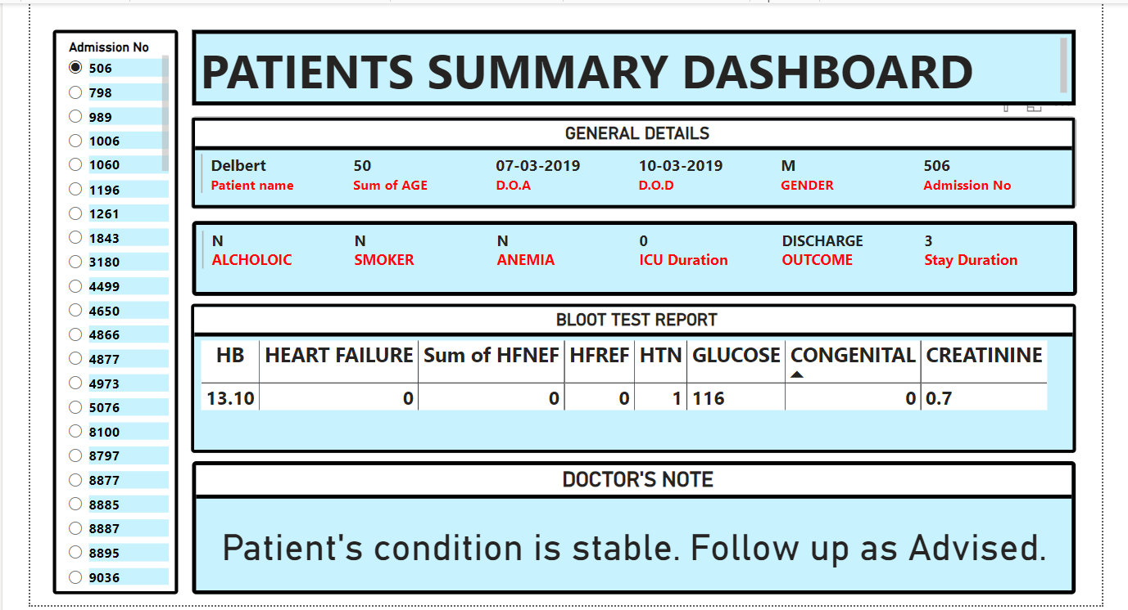
WORK DONE
11

Slide 11
FUTURE ASPECTS
Looking ahead, the evolution of customer performance dashboards in Power BI is poised to embrace several exciting advancements. One key aspect is the integration of AI and machine learning capabilities for predictive analytics, enabling organizations to forecast customer behaviors and trends more accurately. Enhanced natural language processing (NLP) features will enable users to interact with dashboards using conversational queries, making insights more accessible to non-technical stakeholders. Improved real-time data processing and IoT integration will provide up-to-the-minute insights, crucial for agile decision-making. Moreover, enhanced customization options and interactive storytelling capabilities will empower users to create more personalized and engaging dashboards tailored to specific business needs. As Power BI continues to innovate, these advancements promise to further enhance the effectiveness and usability of customer performance dashboards, driving deeper insights and strategic actions for businesses worldwide.
12

Slide 12
CONCLUSION
A Patient Summary Dashboard in Power BI is an invaluable asset for healthcare providers, offering an integrated and dynamic platform to monitor and analyze patient data. By utilizing Power BI's robust data integration and visualization capabilities, the dashboard delivers a holistic view of patient health metrics, medical history, and treatment outcomes. This enhances clinical decision-making, improves patient care, and operational efficiency, while ensuring data security and regulatory compliance. With features like real-time alerts, interactive drill-downs, and customizable views, healthcare professionals can swiftly respond to critical situations and maintain a high standard of patient management. The implementation of such a dashboard ultimately leads to better patient outcomes and a more efficient healthcare delivery system.
13

Slide 13
THANK YOU
14

